Slide 1

A PROJECT PRESENTATION ON
Hi Five Sharing
MCA SEM 6th
^{Group No:?}
Internal Guide:
Dr.Tulsidas Nakrani
External Guide:
Mr. Chetan Soni
Developed By:
Patel Vivek D.
(2016095900000475)
Patel Priya S.
(2016095900000606)
Submitted To:
Department Of Computer Application(Sankalchand Patel College Of Engineering,Visnagar)
Sankalchand Patel University,Visnagar.

Slide 2
Project Profile
Project Title | Hi Five Sharing
Project Definition | Using This system User can upload and view photos and videos of another user, user also can comments and like videos and photos
Objective | objective of this website is to create a network through which users can communicate with each other and also they can also book packages online
External Project Guide | Mr. Chetan Soni
Internal Project Guide | Dr.Tulsidas Nakrani
Team Size | TWO MEMBER
Team Member | 1) Patel Vivek D. (2016095900000475) 1) Patel Priya S. (2016095900000606)
Front End Tool | PHP (7.4.3)
Back End Tool | My SQL (5.6.17)
Report Generation Tools | MS Office 2016
Operating System | Window 10
Project Duration | 4 Months

Slide 3

Organization Profile
Name:- NIVAAN INFOTECH
Address:- F-42, Tirupati Metro Mall, Near Shahibaug Society, Visnagar-384315.
Website:- www.nivaaninfotech.com
E-Mail:- nivaaninfotech@nivaaninfotech.com
Owner:- Mr. Chetan Soni
About Company:-Nivaan Infotech Presently Based At Visnagar In North Gujarat Is Dedicated To Provide Quality Based. Satisfactory & Cost Effective Services. We Believe In Implementing Innovation Ideas & Maintaining Quality Standards.

Slide 4
Problem Of Existing System
User can not select package online.
User can not post and comments
Otp facility was not available.
Existing system is time consuming
User can not rate post online

Slide 5
Need For New System
For the better searching facility as per user convenient.
Much more profile for user to explore.
To include OTP facility in the system.
To include SMS and email notification facility.
To include like and comments facility to the system.
To include dynamic package facility.

Slide 6
Modules
Admin :
Login
Manage User
Manage Photos and videos
Manage package
Manage package Booking.
Manage package payments
Manage Comments and likes
Manage Contact
Manage feedback
MANAGE FAQ

Slide 7
User :
Home
Edit Profile
Upload photos and videos
View/select package
Book package
Make payments
Make like and comments
User can send a message to another user
Feedback
FAQ
Logout

Slide 8
TimeLine Chart
Days | Dec 2020 to | 5 | 10 | 15 | 20 | 25 | 30 | 35 | 40
Definition
System Analysis
Database design
Page design

Slide 9
H/W & S/W Specification(Recommended)
Developer Side:- | Client Side:-
Hardware Specification | Hardware Specification
RAM :- 512MB(minimum) HARD-DISK :- 30 GB Processor :- Pentium 2.10 GHz | RAM :- 512MB HARD-DISK :- 30 GB Processor :- Pentium 2.10 GHz & Above
Software Specification | Software Specification
FRORNT END :- PHP BACKEND :- PHPMYSQL TOOLS :- VSCODE, VISIO, DREAMWEAVER | BROWSER :- BRAVE, CHROME, INTERNET EXPLORER

Slide 10
DATA DICTIONARY
List Of Tables
tbl_user
tbl_login
tbl_post
tbl_package
tbl_package_payments
tbl_package_booking
tbl_messages
tbl_comments
tbl_contact_us
tbl_subscribe
tbl_Likes
tbl_feedback
tbl_FAQs

Slide 11
Table No:-1
Table Name:- tbl_user
Primary Key:- user_id
Description: : This Table is used to store user details
Field Name | Type/Size | Constraints | Description
user_id | int(3) | Primary Key | This field contains user id.
first_name | varchar(50) | Not Null | This field contains first name.
last_name | varchar(50) | Not Null | This field contains last name.
user_image | Varchar(50) | Not Null | This field contains user image
xender | Varchar(10) | Not Null | This field contains xender
email_id | varchar(50) | Not Null | This field contains email id.
mobile_no | varchar(10) | Not Null | This field contains mobile Number.
password | varchar(6) | Not Null | This field contains password
city | varchar(30) | Not Null | This field contains city.
address | longtext | Not Null | This field contains address.
otp | int(6) | Not Null | This field contains otp
timestamp | datetime | Not Null | This field contains timestamp.

Slide 12
Table No:- 2
Table Name:- tbl_login
Description: : This Table is used to store user Log in details
Field Name | Type/Size | Constraints | Description
login_id | int(3) | Primary Key | This field contains login id.
email_id | varchar(50) | Not Null | This field contains email id.
password | varchar(6) | Not Null | This field contains password.
type | varchar(6) | Not Null | This field contains type.
timestamp | Datetime | Not Null | This field contains timestamp.

Slide 13
Table No: - 3
Table Name:- tbl_Post
Primary Key:- post_id
Foreign Key:- user_id(References for table tbl_User)
Description: This Table is used to store user Post like Photos and Videos
Field Name | Type/Size | Constraints | Description
post_id | int(3) | Primary Key | This field contains post id.
user_id | int(3) | Foreign key | This field contains user Id
likes | int(3) | Null | This field contains Likes
post | text | Not Null | This field contains post.
type | Varchar(6) | Not Null | This field contains type.
post_title | varchar(100) | Not Null | This field contains post title
post_caption | longtext | Not Null | This field contains post caption
timestamp | datetime | Not Null | This field contains timestamp.

Slide 14
Table No:-4
Table Name:- tbl_Package
Primary Key:- Package_id
Description: : This Table is used to store packages
Field Name | Type/Size | Constraints | Description
package_id | int(3) | Not Null | This field contains package id.
package_price | int(5) | Not Null | This field contains package price
package_description | longtext | Not Null | This field contains package description.
package_title | varchar(50) | Not Null | This field contains package title.
package_size | int(3) | Not Null | This field contains package size.
package_startdate | datetime(6) | Not Null | This field contains package startdate.
package_enddate | datetime(6) | Not Null | This field contains package enddate.
duration | Int(3) | Not Null | This field contains duration.

Slide 15
Table No:-6
Table Name:- tbl_Packagebooking
Primary Key:- booking_ID
Foreign Key:- package_id(References for table tbl_Package),
User_id (References for table tbl_User),
Description: : This Table is used to store user package booking details
Field Name | Type/Size | Constraints | Description
booking_id | int(3) | Not Null | This field contains booking id.
package_id | int(3) | Foreign key | This field contains package id.
user_id | Int(3) | Foreign key | This field contains user id.
payment_status | Varchar(10) | Not Null | This field contains payment status.
timestamp | datetime | Not Null | This field contains timestamp .

Slide 16
Table No:-5
Table Name:- tbl_PackagePayments
Primary Key:- Payments_id
Foreign Key:- user_ID(References for table tbl_User),
package_id(References for table tbl_Package)
Description: This Table is used to store user payments details.
Field Name | Type/Size | Constraints | Description
payments_id | int(3) | Not Null | This field contains payment id.
user_id | int(3) | Foreign key | This field contains user id.
package_id | int(3) | Foreign key | This field contains package id.
Package_name | Varchar(50) | Not Null | This field contains package name.
Card_name | Varchar(50) | Not Null | This field contains card name.
card_no | int(16) | Not Null | This field contains card No.
expire_date | Date | Not Null | This field contains expire date.
timestamp | datetime | Not Null | This field contains timestamp.

Slide 17
Table No:-7
Table Name:- tbl_Messages
Primary Key:- Messages_id
Foreign Key:- user_id(References for table tbl_User)
Description: This Table is used to store user Messages.
Field Name | Type/Size | Constraints | Description
messages_id | int(3) | Not Null | This field contains messages id.
user_id | int(3) | Foreign key | This field contains user id.
messages | Longtext | Not Null | This field contains messages.
timestamp | datetime | Not Null | This field contains timestamp.

Slide 18
Table No:-8
Table Name:- tbl_Comments
Primary Key:- Comments_id
Foreign Key:- user_id(References for table tbl_User)
Description:- This Table is used to store user comments.
Field Name | Type/Size | Constraints | Description
comments_id | int(3) | Not Null | This field contains comments id.
user_id | int(3) | Foreign key | This field contains user id.
Post_id | int(3) | Not null | This field contains user post.
comments | longtext | Not Null | This field contains comment.
timestamp | datetime | Not Null | This field contains timestamp.

Slide 19
Table No:-9
Table Name:- tbl_ContactUs
Primary Key:- Contact_id
Description: This Table is used to store user contact details.
Field Name | Type/Size | Constraints | Description
contact_id | int(3) | Primary Key | This field contains contact id.
full_name | varchar(50) | Not Null | This field contains full name.
subject | varchar(60) | Not Null | This field contains subject.
email_id | varchar(50) | Not Null | This field contains email id.
mobile_no | Varchar(10) | Not Null | This field contains mobile no
messages | Longtext | Not Null | This field contains messages.
timestamp | datetime | Not Null | This field contains timestamp.

Slide 20
Table No:-10
Table Name:- tbl_Subscribe
Primary Key:- Subscribe_id
Description: This Table is used to store user Subscription details
Field Name | Type/Size | Constraints | Description
subscribe_id | int(3) | Primary Key | This field contains subscribe id.
email_id | varchar(50) | Not Null | This field contains email id.
timestamp | Datetime | Not Null | This field contains timestamp.

Slide 21
Table No: - 11
Table Name:- tbl_Likes
Primary Key:-likes_id
Foreign Key:- user_id(References for table tbl_USER)
,post_id(References for table tbl_Post)
Description: This Table is used to store user likes information
Field Name | Type/Size | Constraints | Description
likes_id | int(3) | primary key | This field contains likes id.
user_id | int(3) | Foreign key | This field contains user id.
post_id | Int(3) | Foreign key | This field contains post id.
like_score | int(5) | not null | This field contains like score.

Slide 22
Table No: - 12
Table Name:- tbl_feedback
Primary Key:- feedback_id
Foreign Key:- user_id(References for table tbl_USER)
Description: This Table is used to store user feedback details
Field Name | Type/Size | Constraints | Description
feedback_id | int(3) | primary key | This field contains feedback id.
user_id | int(3) | foreign key | This field contains user id.
responce | Longtext | not null | This field contains responce.
timestamp | Datetime | not null | This field contains timestamp.

Slide 23
Table No: - 13
Table Name:- tbl_FAQs
Primary Key:-faqs_id
Foreign Key:- user_id(References for table tbl_user)
Description: This Table is used to store user questions and answered
Field Name | Type/Size | Constraints | Description
faqs_id | Int(3) | primary key | This field contains faqs id.
user_id | Int(3) | foreign key | This field contains user id.
questions | Varchar(50) | not null | This field contains questions.
answeres | Longtext | not null | This field contains answeres.

Slide 24
Use Case
Diagram

Slide 26
E-R
Diagram

Slide 27
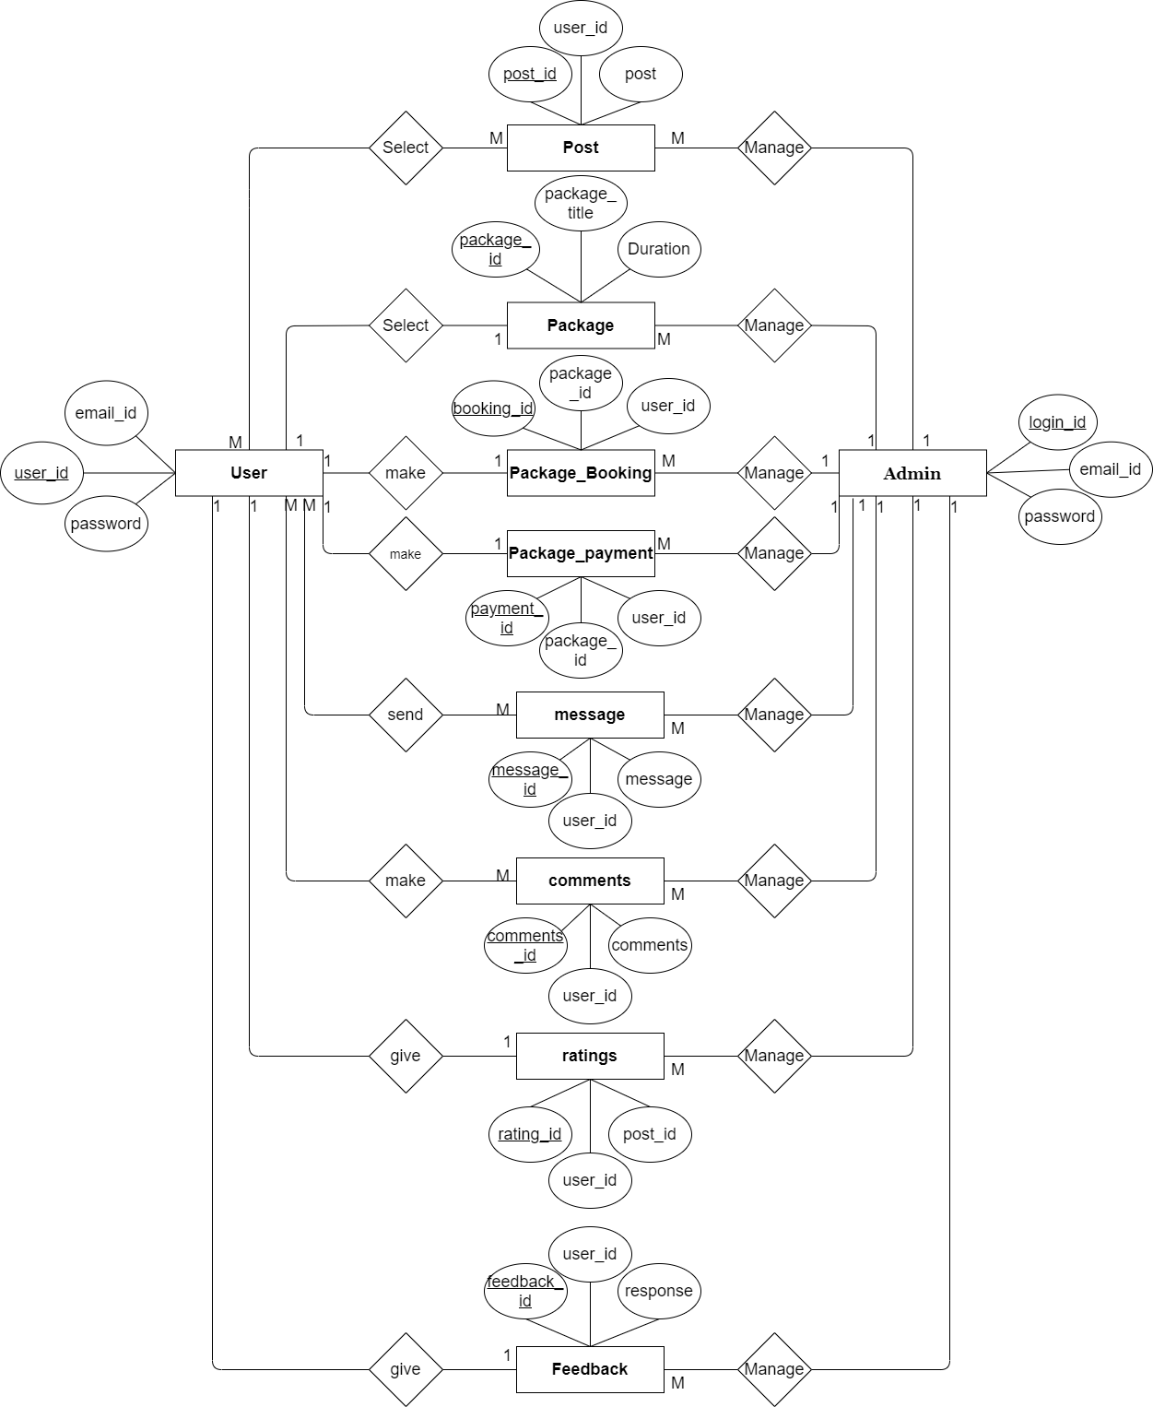

Slide 28
Class
Diagram

Slide 30
Activity
Diagram

Slide 31
User

Slide 32
Admin

Slide 33
Sequence Diagram
(Admin)

Slide 34
Admin
System
Database
login
request
authentication of login
email & password verified
manage user
request user detail
display user detail
response display user detail
manage post
Request for update post
display post detail
receive post
manage package
Add package
successfully add package
Request add package
manage package bookng
Receive usre package booking detail
successfully update package booking
update package booking detail
Manage package payment
Request for update save payment
successfully update
Updat payment detail
manage message
Request for add message
successfully add message
request add message detail
manage comment
View/update comment
Succesfully update comment
Request for view/update comment
manage like
Request for update/save like
Succesfully update/save like
update/save like
manage feedback
Request for update/save feedback
successfully update
Update feedback detail
logout
successfully logout

Slide 35
Sequence Diagram
(User)

Slide 36
User
System
Database
registration user
registration detail
confirm registration
save detail
login
request
authentication of login
email & password varified
user detail
request for user detail
display user detail
response display user detail
manage profile
request for manage profile
display manage profile detail
response display maange profile detail
update/view post
request update post
Succesfully update post
response update/view post
view./select package
request select package
Succesfully select package
response user select package
book package
request for book package
Succesfully select book package
response user book package
make payment
request for payment
display payment detail
Response display payment detail
Send message
request send message detail
Seccesfully send message
response for send message
Send comment
view/update comment
Seccesfully update comment
request for view/update comment
Manage like
request for update/save like
Seccesfully update/save like
update/save like
give feedback
request for feedback
display feedback
response display feedback detail
logout
Successfully logout

Slide 37
Deployment
Diagrams

Slide 38
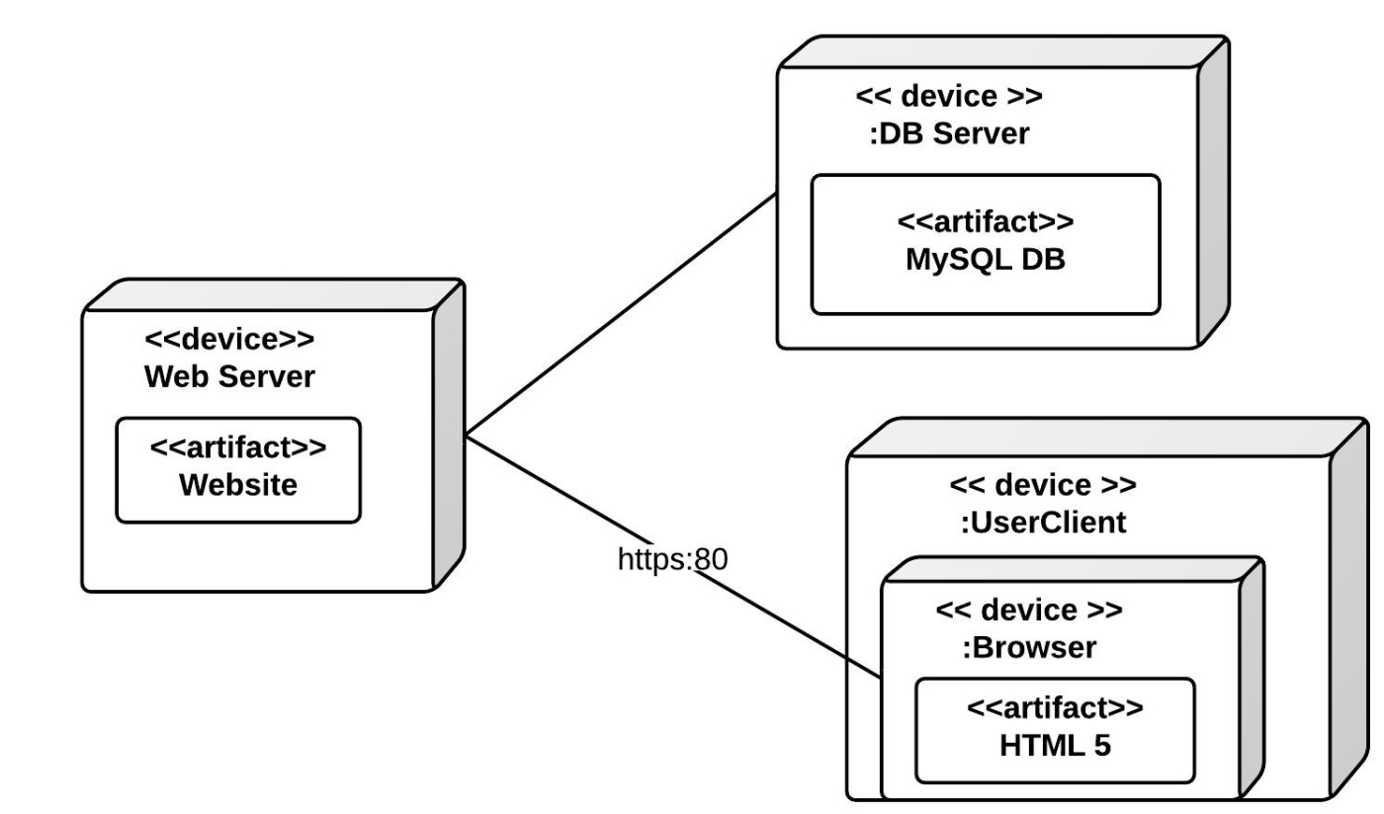

Slide 39
Reference
https://www.dropbox.com/features/cloud-storage/photos
https://www.tomsguide.com/best-picks/best-photography-sites

